Slide 1
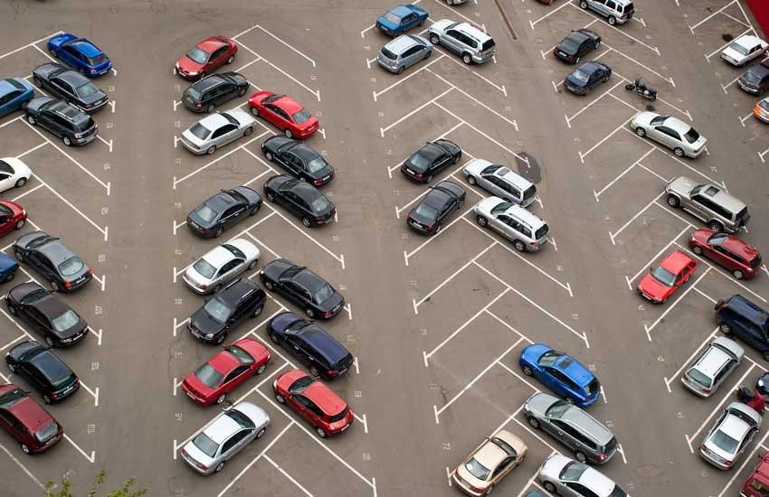
PARKING LOT SPACE DETECTION USING OPENCV

Slide 2
Contents
Abstract
Introduction
Problem Statement
Technology and Classifier Used
Project Flow
Haar Cascade Classifier
Training Classifier
Accuracy
Program Flow
Working with OPENCV
Preprocessing
Gaussian blur
Laplacian of Gaussian Filter
Running the classifier based on status change
Demonstration of the project
Conclusion and Future Work
References

Slide 3
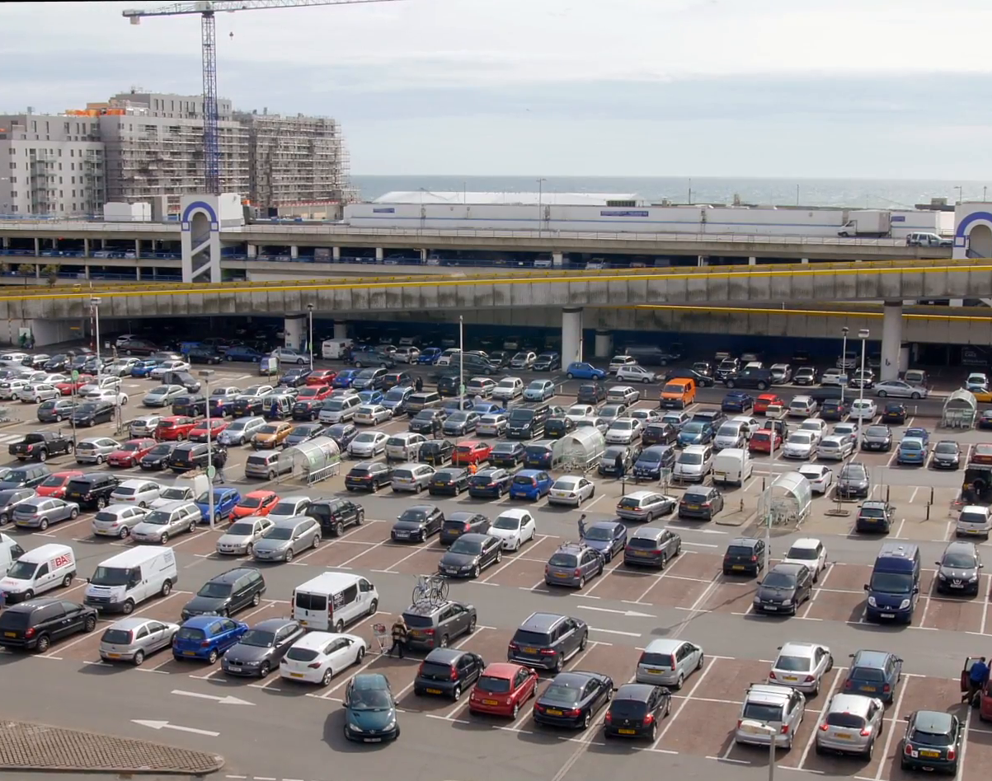
Abstract
A system is proposed which classifies the parking space as occupied or vacant.
The system uses a combination of Laplacian operator for edge detection, HAAR classifier for object recognition and motion tracking to distinguish between the parked and vacant spaces. Motion tracking using background subtraction techniques, contours and Morphological operations is used

Slide 4
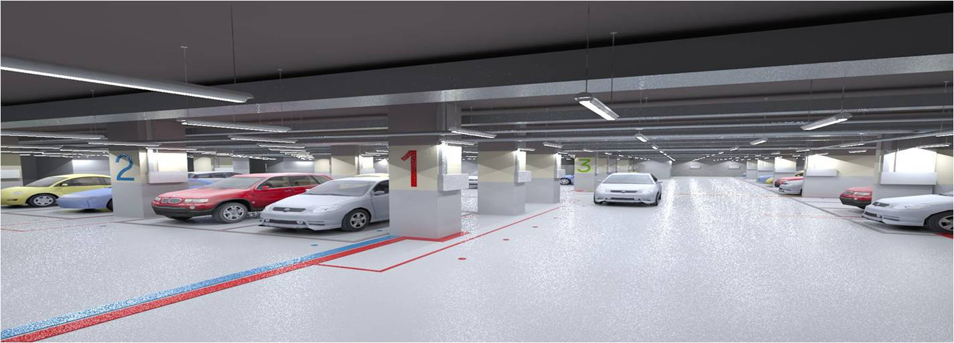
Introduction
A problem faced in major metropolitan areas is the search for parking space. Looking for parking space always wastes travelling time
Unsupervised parking lots detection has been currently employed in many systems for counting the number of parking spaces, identifying the location, monitoring the changes of space status over the time.

Slide 5
Problem Statement
In the modern society, there are an ever-increasing number of vehicles. This is leading to problems such as large urban parking lots becoming inefficient, increasing difficulty to find open spaces in busy parking lots, as well as the increasing need to devote larger areas of land for additional parking spaces.
● On average, 3.5 - 12 minutes spent waiting for a spot in urban parking lots
● Average distance traveled looking for a spot = 1.2km
● There were 788 parked car collisions, 5 being fatal
● Average CO2 produced per car per day = .14 kg CO2
src:https://inrix.com/press-releases/cod-us/

Slide 6

Technologies And Classifier Used
Python
OpenCV
Laplacian of Gaussian Filter
Motion detection algorithm
Haar-Cascade Classifier

Slide 7
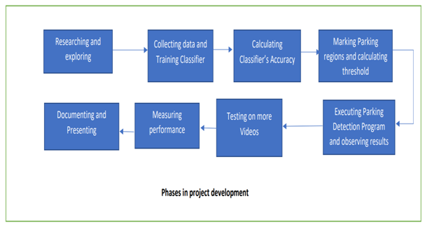
Project Flow

Slide 8
Haar-cascade classifier
Object Detection using Haar feature-based cascade classifiers is an effective object detection method proposed by Paul Viola and Michael Jones in their paper, "Rapid Object Detection using a Boosted Cascade of Simple Features" in 2001.
The main reason behind selecting the Haar-cascade classifier is due its use of Haar-like features.The key advantage of a Haar-like feature over most other features is its calculation speed. Due to the use of integral images, a Haar-like feature of any size can be calculated in constant time

Slide 9
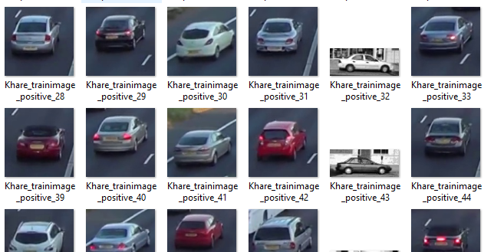
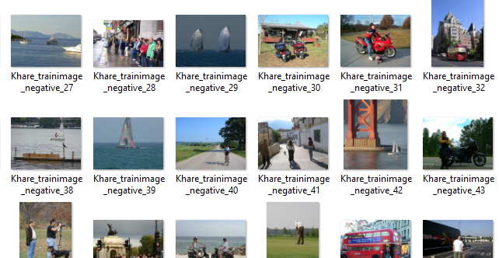
Training Classifier
It is a machine learning based approach where a cascade function is trained from a lot of positive and negative images. It is then used to detect objects in other images.
The classifier is again trained with images where the classifier fails in conditions where the cars are dark in color or with presence of any shadows on cars or obstruct by any trees.

Slide 10
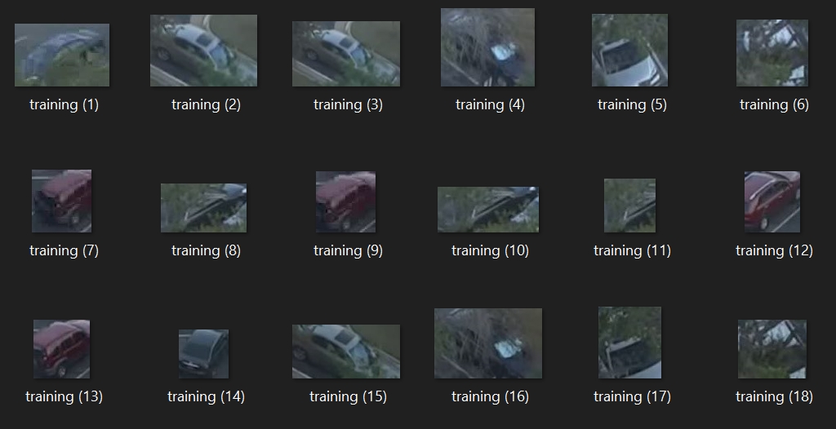
`

Slide 11
Classifier Trained with: 619 Positives and 1002 Negatives
Number of Frames used: 5
Mean of individual Accuracies: 50.841%
Classifier Trained with: 1237 Positives and 1527 Negatives
Number of Frames used: 5
Mean of individual Accuracies: 75.58%
Accuracy

Slide 12
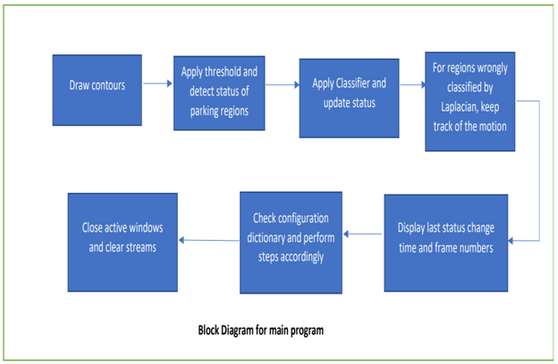
Program Flow

Slide 13

Working with OPENCV
Capture Video from Camera
Drawing the Contours
Playing Video from file
Motion Detection

Slide 14
Running the Classifier based on status change
OpenCV motion detection algorithm is used, if there is a change in motion in a certain contour we apply Laplacian of gaussian edge detection algorithm on each contour
If the Laplacian of the contour is greater than the calculated laplacian threshold then we run the cascade classifier so as to identify the presence of a car
For the region wrongly classified by the LoG, we keep the track of the motion and can be identified as pedestrians or any other vehicles or objects.

Slide 15
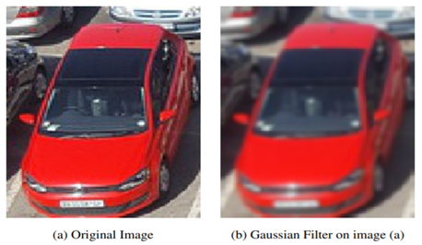
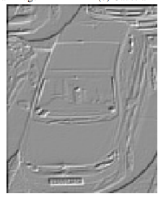
Gaussian Blur
Preprocessing
In image processing, a Gaussian blur (also known as Gaussian smoothing) is the result of blurring an image by a Gaussian function
Grey Scaling
A grayscale (or gray level) image is simply one in which the only colors are shades of gray.

Slide 16
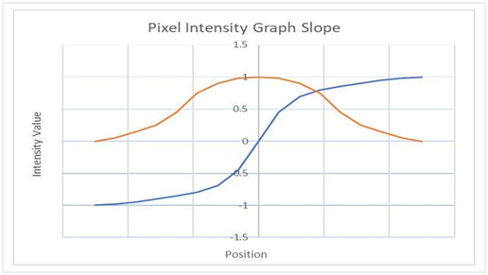
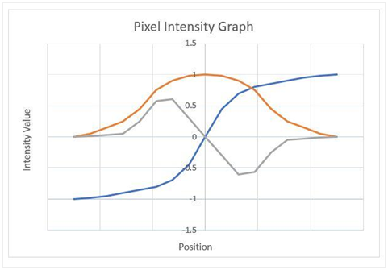
Laplacian of Gaussian filter
Laplacian of Gaussian is popular edge detection algorithm. Edge detection is an important part of image processing and computer vision applications. It is used to detect objects, locate boundaries, and extract features. Edge detection is about identifying sudden, local changes in the intensity values of the pixels in an image.

Slide 17
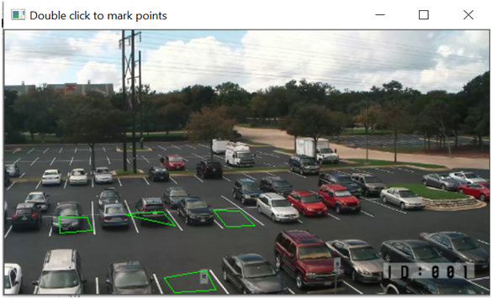
Demonstration of the project
Drawing Contours and generating a yaml file to store the coordinates of the contours

Slide 18
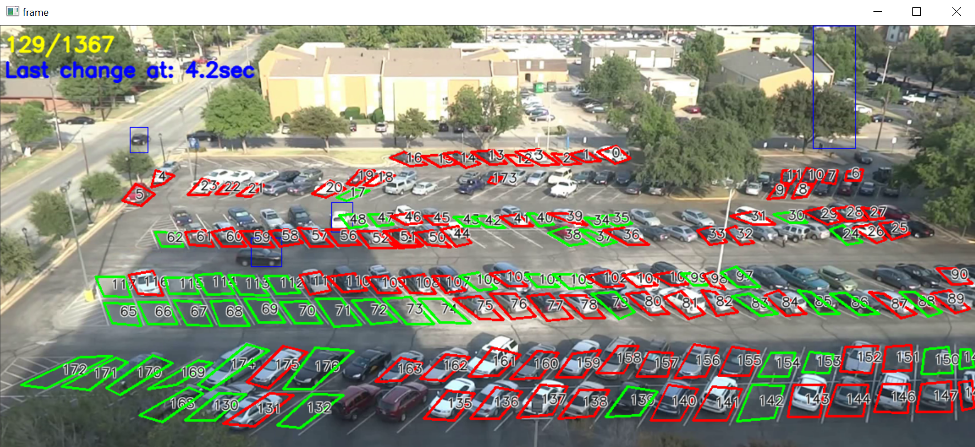
Demonstration of the project contd.
Green Contours indicate an empty space
Red contours indicate occupied spots

Slide 19
CONCLUSION AND FUTURE WORK
The system proposes an effective methodology to manage parking systems using a camera placed for a lamp-post view. The accuracy of the system is dependent on the laplacian threshold, motion tracking algorithm based on background subtraction and most importantly, the strength and speed of the classifier.
HAAR classifiers do a decent job but implementing a classifier based on Convolution Neural Networks will greatly increase the overall accuracy of the system but requires high computation power.
As of now the system has been found working with an accuracy of more than 75% with 4 parking lots.

Slide 20
References
Fabian, T. (2008). An algorithm for parking lot occupation detection. Computer Information Systems and Industrial Management Applications (pp. 165-170). IEEE
Prince 2012] Simon J. D. Prince. Computer Vision: Models, Learning, and Inference. Cambridge University Press, New York, NY, USA, 1st edition, 2012
A. Broggi, E. Cardarelli, S. Cattani, P. Medici and M. Sabbatelli, "Vehicle detection for autonomous parking using a Soft-Cascade AdaBoost classifier", IEEE Intell. Veh. Symp. Proc., no. November, pp. 912-917, 2014.
https://inrix.com/press-releases/cod-us/

Slide 21
Thank you
By
J. Sai Charan - 17011U0507
Mudassir Ahmed - 17011U0503

